Slide 1


Credit Card Financial Analysis
Power Bi + SQL Project
This Photo by Unknown Author is licensed under CC BY-NC

Slide 2


Credit Card Financial Analysis
Name – Nilam Lokhande
Project – Credit Card Transaction And Customers Analysis
Tool – Power Bi + SQL
Linkedin – https://www.linkedin.com/in/nilam-lokhande-b043a2376/
Github - https://github.com/nilamokhande/ Credit_card_Financial_Dashboard

Slide 3
Credit Card Financial Analysis
Project Overview / Objective
This project analyzes credit card transactions and customer data to identify spending trends, customer segmentation, and revenue insights using Power BI and SQL.
Goals
Track total revenue and weekly performance
Analyze customer behavior by age, income, and satisfaction
Identify key revenue-driving payment modes and card categories

Slide 4
Credit Card Financial Analysis
Tools & Technologies
Purpose | Tool
Data Source | CSV files (imported to SQL)
Database Querying | SQL
Data Cleaning & Modeling | Power Query
Data Visualization | Power BI
Calculations | DAX Measures

Slide 5
Credit Card Financial Analysis
Data Model View
cust_detail (Customer Table)
cc_detail (Transaction Table)
Relationship:
cust_detail[Client_Num] 1 —— * cc_detail[Client_Num]
“ I used a star schema model with one fact table and one dimension table for better query performance.”

Slide 6
Credit Card Financial Analysis
DAX Measures
(Core Calculations)
This DAX used in Project-
AgeGroup
IncomeGroup
Week_num2
Revenue
Current_Week_Revenue
Previous_Week_Revenue
WOW_Revenue
Total_Customers
Total_Transactions
1) Revenue = 'ccdb cc_detail'[Annual_Fees]
+ 'ccdb cc_detail'[Total_Trans_Amt]
+ 'ccdb cc_detail'[Interest_Earned]
Calculates total revenue per transaction
2) WOW_Revenue = DIVIDE(
[Current_Week_Revenue] - [Previous_Week_Revenue],
[Previous_Week_Revenue],0)
3) Shows week-over-week growth

Slide 7
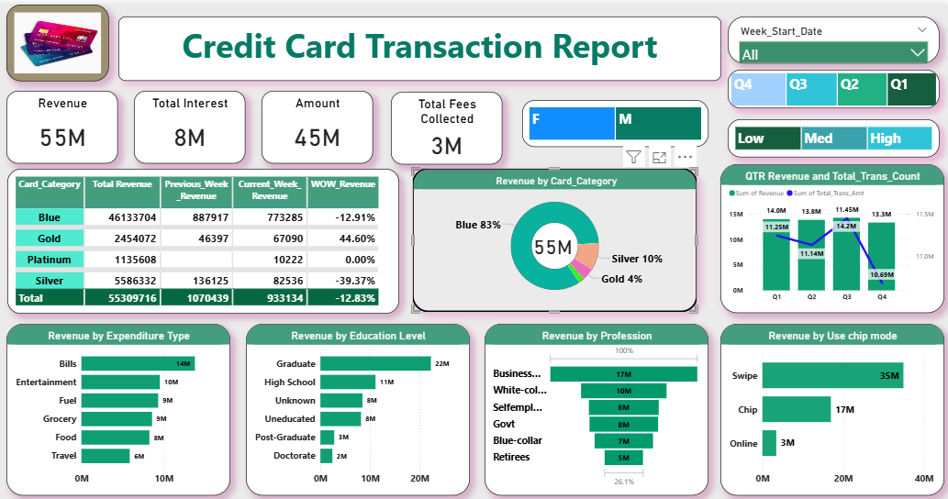

Slide 8
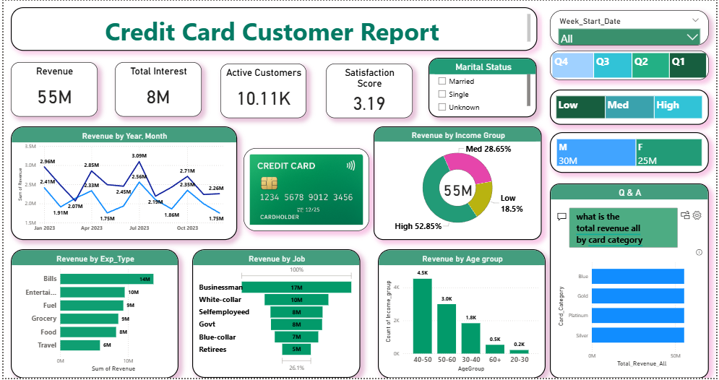

Slide 9
Credit Card Financial Analysis
Key Insights
Total revenue analyzed: $55M+
Highest revenue from Silver cards around 31%
Swipe mode contributed 60%+ of total transactions
Age group 40–50 generates maximum revenue
High-income group (>70K) contributes 53% of total sales

Slide 10

Credit Card Financial Analysis
Recommendations
Business can grow using this my findings-
Promote online payment offers for younger customers
Encourage auto-pay to reduce late payments
Focus marketing on 40–50 age group of customers and Platinum cards
This Photo by Unknown Author is licensed under CC BY-NC

Slide 11
Credit Card Financial Analysis
Learning
Data modeling using Star Schema
Writing complex DAX expressions
Building dynamic dashboards with slicers
Connecting SQL → Power BI
Applying data storytelling and KPI design

Slide 12
Thank You

